Slide 1
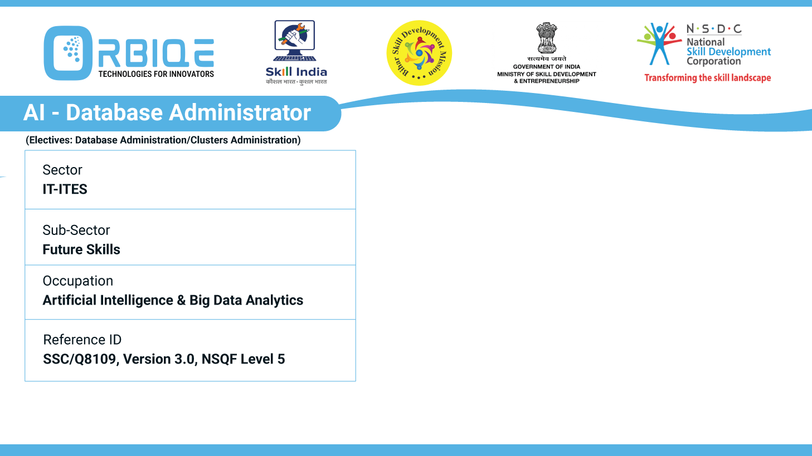
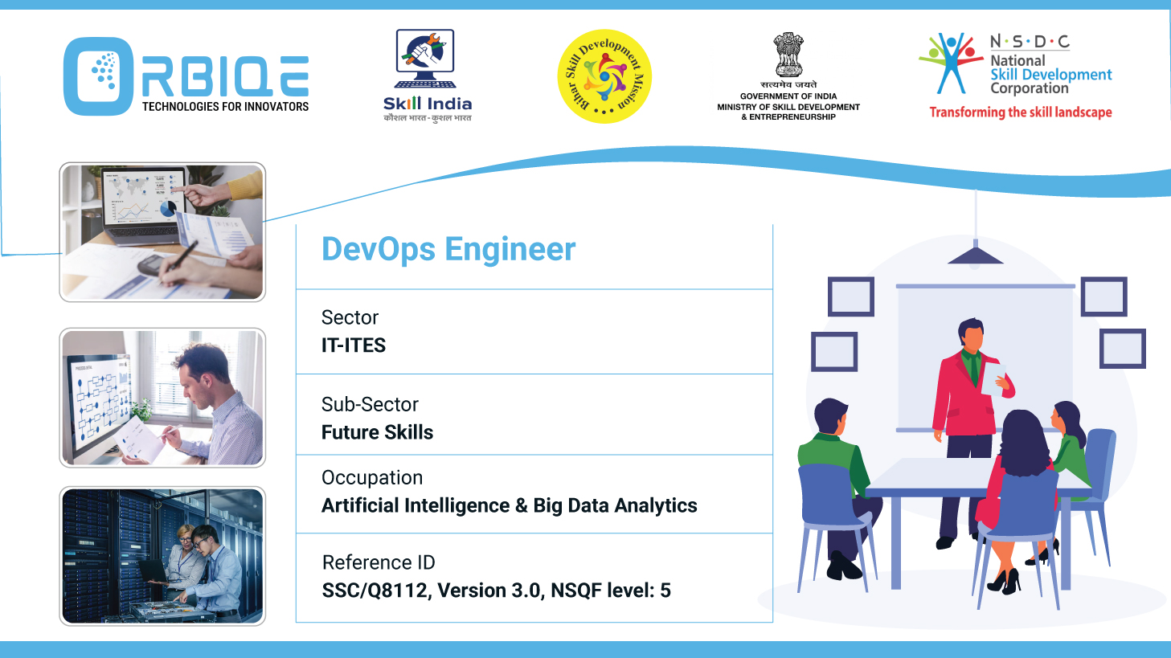
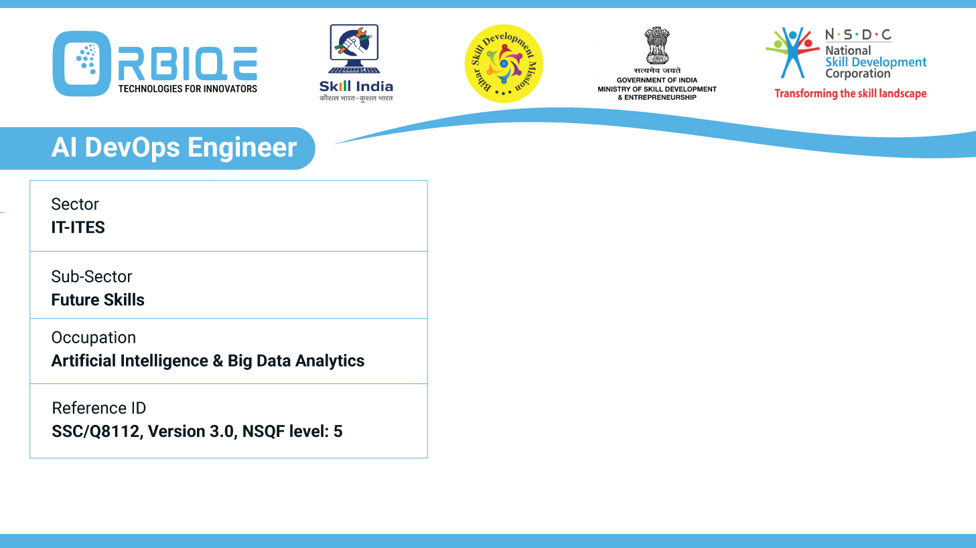
Name- Krishna Kant Dubey

Slide 2

Data Security: Safeguarding Against Threats

Slide 3
Agenda
Explore strategies and tools for securing data
Authentication, network security, and virus protection in the context of AI Database Administration

Slide 4
Key Strategies for Securing Data
Data Classification
Access Control
Encryption
Multi-Factor Authentication (MFA)
Security Policies and Training
Monitoring and Auditing
Data Minimization and Retention

Slide 5
Authentication
Password-Based Authentication
Users provide a username and password stored in the database.
Common in SQL databases like MySQL, PostgreSQL, and SQL Server.
Operating System Authentication
The database trusts the operating system to authenticate users.
Often used in enterprise environments for seamless access control.
Certificate-Based Authentication
Uses digital certificates to verify identity.
Common in secure, encrypted connections (e.g., SSL/TLS).

Slide 6
Authentication
Multi-Factor Authentication (MFA)
Combines two or more verification methods
(e.g., password + OTP).
Adds an extra layer of security.
Token-Based Authentication
Uses access tokens (e.g., JWT) for session-based
authentication.
Popular in web applications and APIs.
LDAP/Kerberos Authentication
Integrates with centralized identity systems like Active
Directory.
Ideal for large organizations with unified user management

Slide 7
Network security
Database network security refers to the combination of strategies, tools, and practices used to safeguard databases from unauthorized access, cyberattacks, and data breaches across a networked environment. It encompasses:
• Data protection within the database
• Protecting the physical or virtual servers
• Securing the network infrastructure used to access the
database

Slide 8
Virus protection in the context of AI Database Administration
Anomaly Detection
AI can monitor database activity and detect unusual patterns
that may indicate a virus or malware infection.
Threat Prediction
Machine learning models analyze historical data to predict potential vulnerabilities or attack vectors.

Slide 9
Virus protection in the context of AI Database Administration
Automated Response
AI systems can automatically isolate affected components, revoke access, or initiate backups when a threat is detected
Behavioral Analysis
AI tracks user behavior to identify compromised accounts or insider threats.

Slide 10
Thank You

